Slide 1
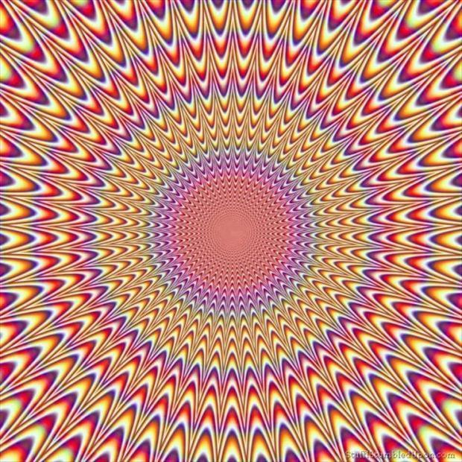

Slide 2
A2 Chemistry
pH

Slide 3
Objectives
indicator colour and the pH scale are used to classify aqueous solutions as acidic, basic or neutral
pH is used as a measure of the acidity of solutions and is dependent on the concentration of hydrogen ions in the solution

Slide 4
Key words
Kw (a measure of how much water ionises)
pH (means “power of hydrogen” – indice)
concentration
(Square brackets represent concentration in mol L⁻¹)

Slide 5

Ionisation of water
Water is a weak electrolyte - it partially ionises
H₂O _{(l)} H⁺ _{(aq)} + OH⁻ _{(aq)}
At 25ºC Kw = [H⁺][OH⁻] = 1.00 x 10⁻¹⁴
The concentration of H⁺ ions in neutral water is equal to OH⁻ ions
[H⁺]=[OH⁻]= 1.00 x 10⁻⁷
Magic number 14: remember pH is 0 to 14
Magic number 7: Remember neutral pH is 7

Slide 6
Determine the [H⁺] and [OH⁻] of a 0.1M HCl
HCl _{(aq)} → H⁺ _{(aq)} + Cl⁻ _{(aq)}
So 0.1 molL-1 of HCl gives 0.1 molL-1 of H⁺
[H+] = 0.1 molL-1
[H+][OH-] = 1.00 x 10 ⁻¹⁴
[OH-]= 1.00x10⁻¹⁴
0.1
[OH-]=1.00x10⁻¹³ molL-1

Slide 7
Determine the [H⁺] and [OH⁻] of a 0.000001M NaOH
NaOH (aq) → Na⁺ (aq) + OH⁻ (aq)
0.000001 molL-1 of NaOH gives 0.000001 molL-1 of OH⁻
[OH-] = 1.00x10⁻⁶ molL-1
Kw=[H⁺][OH-]=1.00x10 ⁻¹⁴
[H⁺]= 1.00x10 ⁻¹⁴
1.00x10⁻⁶
[H+]=1.00x10 ⁻⁸molL-1

Slide 8
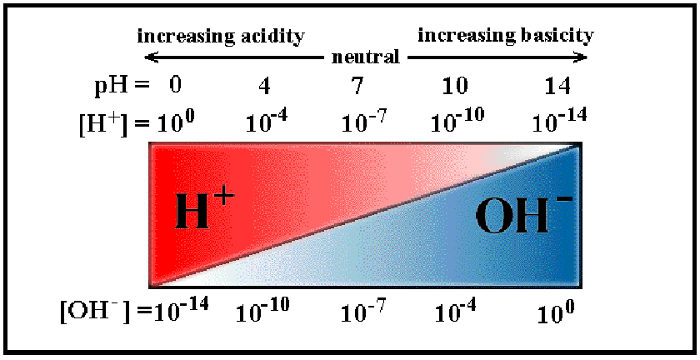

Slide 9
pH
A measure of acidity or alkalinity
pH = - log [H⁺]

Slide 10
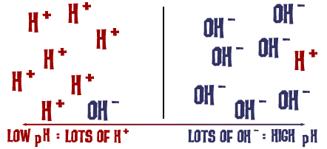
pH is a balance between H⁺ and OH⁻

Slide 12
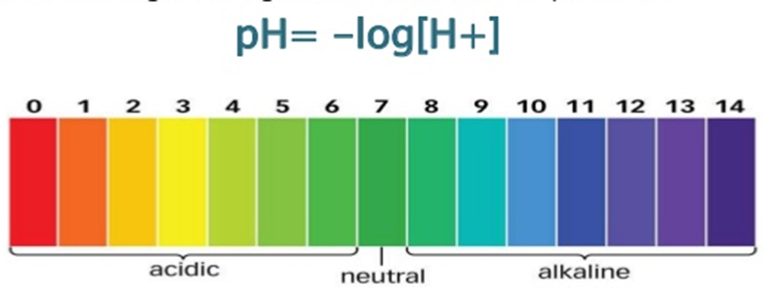

Slide 13
Determine the pH of a 0.1M HCl
[H] = 0.1molL-1
pH= -log[H⁺]
=-log 0.1
= 1.00
NB There are no units for pH

Slide 14
Determine the pH of a 0.000001M NaOH
[OH-] = 0.000001 molL-1 = 1.00 x 10⁻⁶ molL-1
Find the H+ first:
Kw=[H⁺][OH-]=1.00x10 ⁻¹⁴
[H+] = 1.00 x 10⁻¹⁴
1.00 x 10⁻⁶
= 1.00 x 10⁻⁸ molL-1
Then find pH
pH= -log [H⁺]
= - log 1.00 x 10⁻⁸
=8.00

Slide 15
